Slide 1
Project Presentation
Parking Management System OpenCV
Name -: Priyanshu Singh
18BET1057

Slide 2
Content
Introduction
System Requirements
Project Explanation & Working

Slide 3
Introduction
OpenCV stands for open source computer vision.
An objection detection system is an application to detect the most salient feature in the given picture in this case it is a vehicle.
The front-end is made on python tkinter(gui application)..

Slide 4
System Requirements
Currently tested on Windows OS
Minimum Ram Requirement 2GB
Hard drive space 1GB
Internet connection required
Latest Browser requred
Pycharm latest version

Slide 5
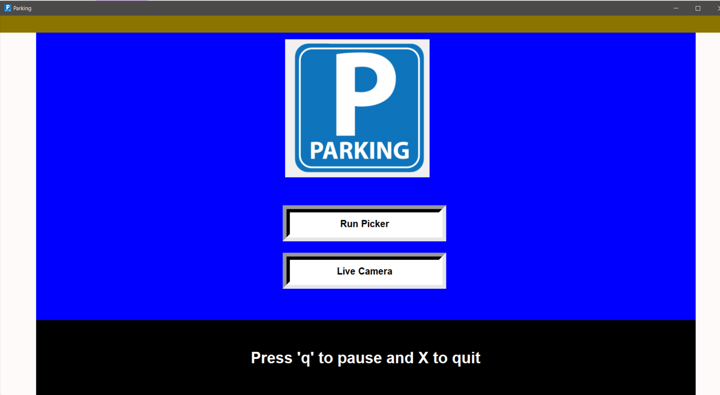
Project Explanation & Working
Front-Page
It consist of 3 colors, 1 center picture and 2 buttons.
Both button is responsive hovering and after click it’s open the camera and picture.
Run picker to alot parking location in image of same parking location
Live camera to run the application

Slide 6
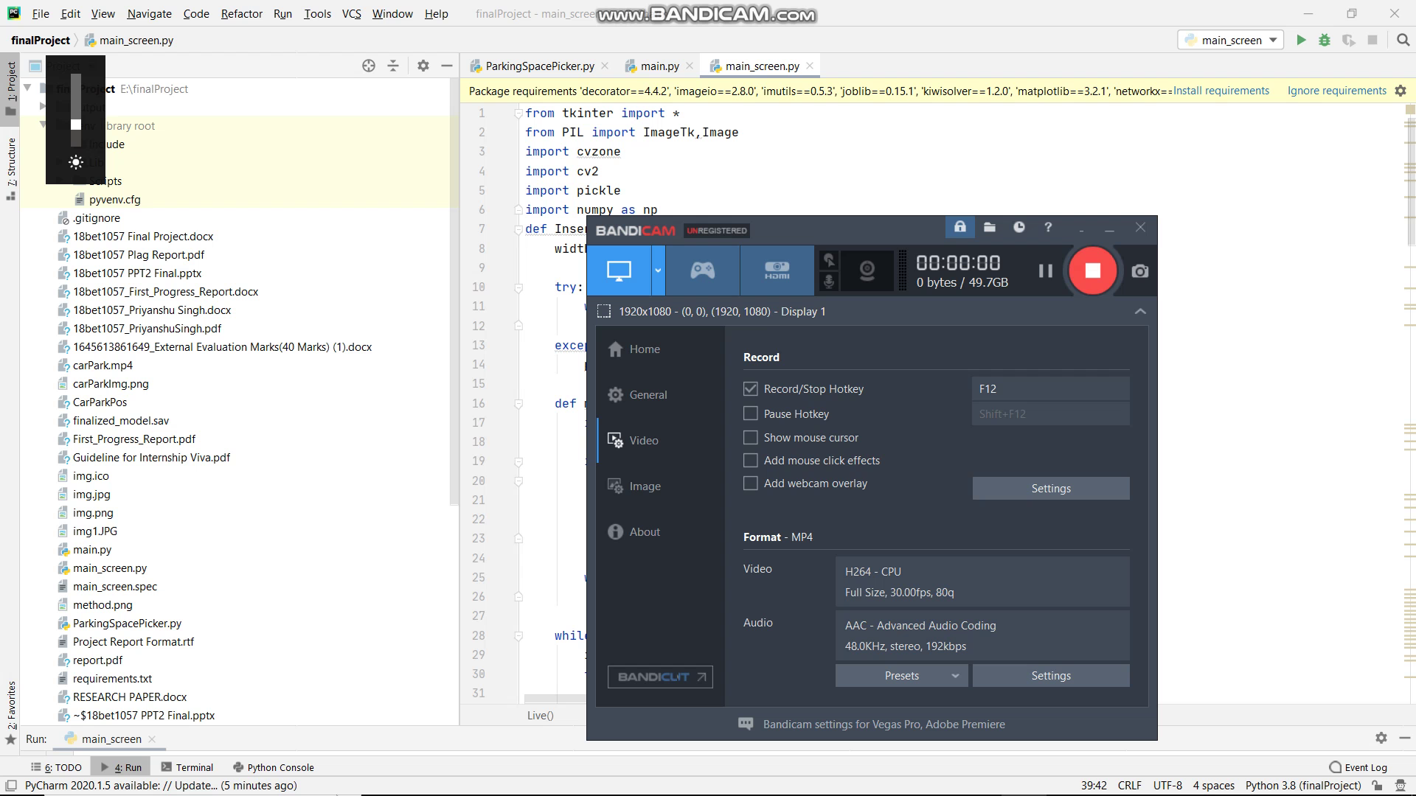
Project Explanation & Working
Video

Slide 7
Thank You

